Slide 1

Thursday, may 14th, 2020
Topic: Photoshop Tools
Objective:
To identify the five categories of Adobe Photoshop tools
To identify the 18 primary tools of the Adobe Photoshop toolbar

Slide 2
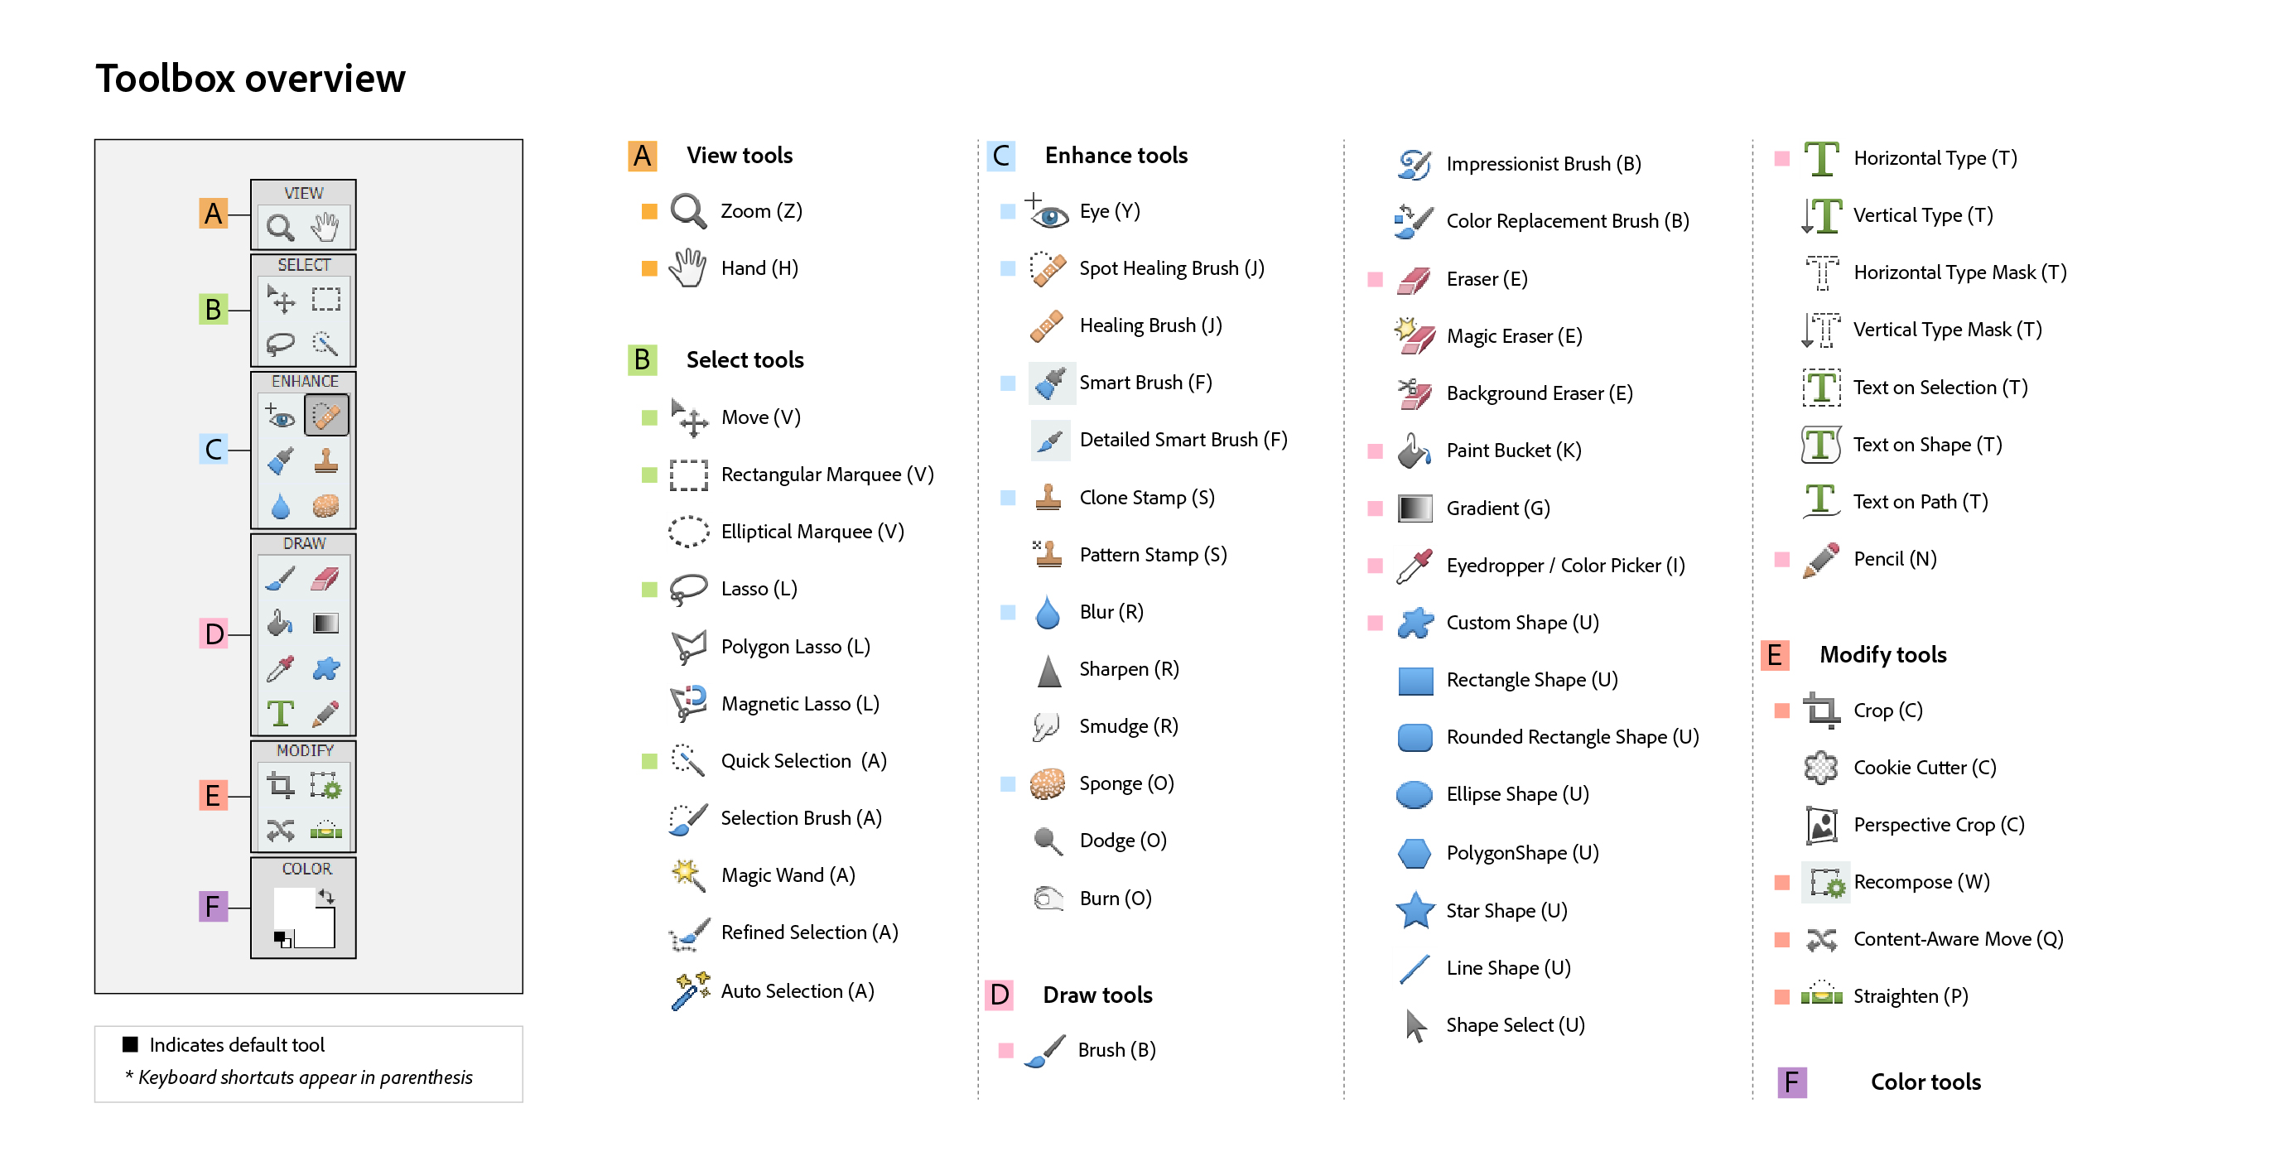
Toolbox Overview

Slide 3
Topic: Illustrator Tools
Objectives:
To have a familiarity with the Illustrator workplace
To identify the organization of Illustrator tools

Slide 4
